Slide 1
Finding Harmony: Establishing Interoperable Standards for Payments amongst DPIs for G2P and Social Protection
Mifos Consortium - Ed Cable - (Mifos Initiative) | Karim Jindani - (Paysys Labs)
GovStack - Wes Brown (DIAL) | Vijay Mauree (ITU)
G2P Connect - Vijay Vujjini (Co-Develop Fund)

Slide 2

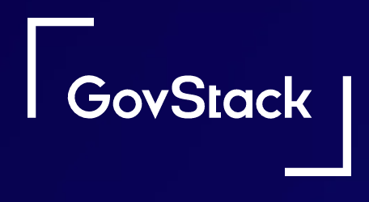










Our Panelists
Edward Cable
President/CEO
Karim Jindani
CEO
Wes Brown
Associate Director / Product Owner - GovStack
Vijay Mauree
Programme Coordinator, ITU
Vijay Vujjini
Technical Consultant, G2P Connect

Slide 3

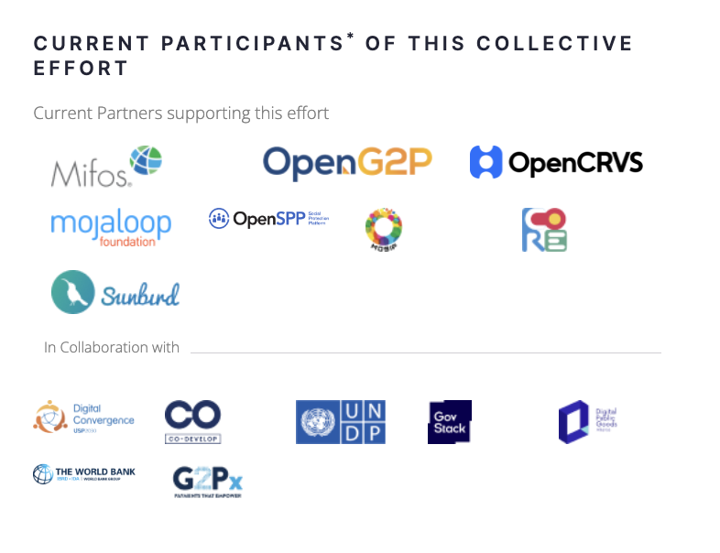





Finding Harmony

Slide 4
Goals of this Panel
Visions for Standards and Interoperability & the Status in Harmonizing Them
Be aware and informed of these ongoing efforts, how they're being aligned, and their latest progress.
Payments Building Block - Closer Look at One Standard & the Role of DPGs & DPIs
Understand the APIs being defined for the Pay-BB standard, and considerations that were made in the design of the API and how DPGs/DPIs are instantiating that standard.
Looking to the Future - Practical ways DPGs/DPIs can interact with the standards and collaborate effectively
Discover what's next and the impact these standards will have on catalyzing adoption and fueling collaboration.

Slide 5
G2P Connect: Mission of this effort
G2P Connect is an open source effort to support
the digital delivery of government-to-person (G2P) payments
It Offers:
A technology architecture blueprint with a plug-and-play architecture (allowing for choice of components) with built in privacy & security
A set of integration specifications to ensure interoperability across the systems supporting G2P delivery
An integration sandbox to support the development of solutions adhering to the blueprint and specifications

Slide 6
Government Ministries & Departments
G2P Connect
Development & Funding Agencies
An open source effort to support G2P digital payments
Leverage
Standards & Specifications Initiatives
Technology architecture blueprint
Integration Specifications
Solution Integration Sandbox
Technology design best practices
Technology Assessment Guides
Contribute
Digital Public Good (DPG) Projects
Proprietary & Existing Systems/Solutions

Slide 7


In summary
G2P Connect is
G2P Connect is not
Open source effort
Set of open interface standards and design templates
End-to-end solution architectural blueprint for G2P payments
Can be incorporated into existing or new systems
Software solution that replaces existing G2P systems
Technology vendor offering a product
System Integrator for G2P payment deployments

Slide 8
Design principles
CHOICE
INCLUSIVE
SCALABLE
INTEGRATED
TRUST
From enrolment to disbursement to last mile cash-in/cash-out.
through technology and accountability
of blocks and multiple paths for deployment
to ensure inclusion of diverse groups by design
to cater to needs of a country / region / or department size
PRIVACY
EFFICIENT
CONFIGURABLE
Plug n Play
Federated
Well designed, documented, and supported software solution blueprint
Can be made interoperable with existing systems (proprietary or open)
Respecting federal nature and autonomy of entities that are managing registries
Respecting privacy of individuals while enabling outreach
Adapt solution into various global contexts and use cases

Slide 9
G2P Connect offers end-to-end set of building blocks
Unified Scheme Visibility for policy makers
(Unified scheme analytics & decision making, privacy protecting design, open data)
Unified Citizen Interface for Scheme Access
(Self-service/assisted, scheme discovery, enrolment, updates, notification, etc.)
Banking/Mobile-wallet System Interface for Citizens
(Self-service/assisted, account opening/management, ID mapper updates, etc.)
Scheme Management
(Beneficiary registry, scheme management, enrolment, approvals, disbursal, monitoring)
Payment & Settlement Switch
(batch / real time / card payments, settlement, reporting, dispute resolution, fraud detection, etc.)
Bank/Mobile-wallet System
(Customer management, account management, payments, FI, ATM/Micro-ATM networks, etc.)
Last Mile Cash-in/Cash-out System
(Cash management, authentication, basic cash-in/cash-out services)
Scheme Management
(Beneficiary registry, scheme management, enrolment, approvals, disbursal, monitoring)
Bank/Mobile-wallet System
(Customer management, account management, payments, FI, ATM/Micro-ATM networks, etc.)
Last Mile Cash-in/Cash-out System
(Cash management, authentication, basic cash-in/cash-out services)
At Department Level (federated and multiple)
Offered by banking/ mobile network partners
Scheme Management
(Beneficiary registry, scheme management, enrolment, approvals, disbursal, monitoring)
Bank/Mobile-wallet System
(Customer management, account management, payments, FI, ATM/Micro-ATM networks, etc.)
Last Mile Cash-in/Cash-out System
(Cash management, authentication, basic cash-in/cash-out services)
Digital ID System
(ID enrolment, management, authentication, eKYC, etc.)
Digital Credentialing Infrastructure
(Credentialing, embeddable into other systems, verifiable, …)
Civil & Other Federated Registries
(Existing digitally accessible registries)
ID-Account Mapper
(ID to account mapper, updates, etc.)

Slide 10
Interfaces…
Financial Address Mapper
Link, Unlink, Resolve
Identity
Verify, De-duplicate
Credentials
Issue, Search, Verify
Registries
Civil Registry
Functional Registry
Social Registry
Program Management
Program
Eligibility Rules
Disburse, Status, Recon
Monitor
Beneficiary Management
Register
Access Eligibility
Enrol
…
https://g2p-connect.gitbook.io/docs

Slide 11
More Information
Website: https://g2pconnect.global
Specifications: https://g2p-connect.gitbook.io/docs
Discussion forum: (create a Github ID using your email so that you can participate) https://github.com/orgs/G2P-Connect/discussions
Documentation index page: https://github.com/G2P-Connect/common/tree/main/docs

Slide 12
Wesley Brown
Digital Impact Alliance
Associate Director, GovStack Product Owner
wbrown@dial.global

Slide 13
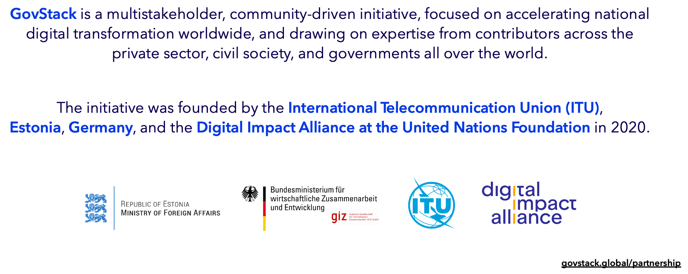
Who is GovStack?

Slide 14
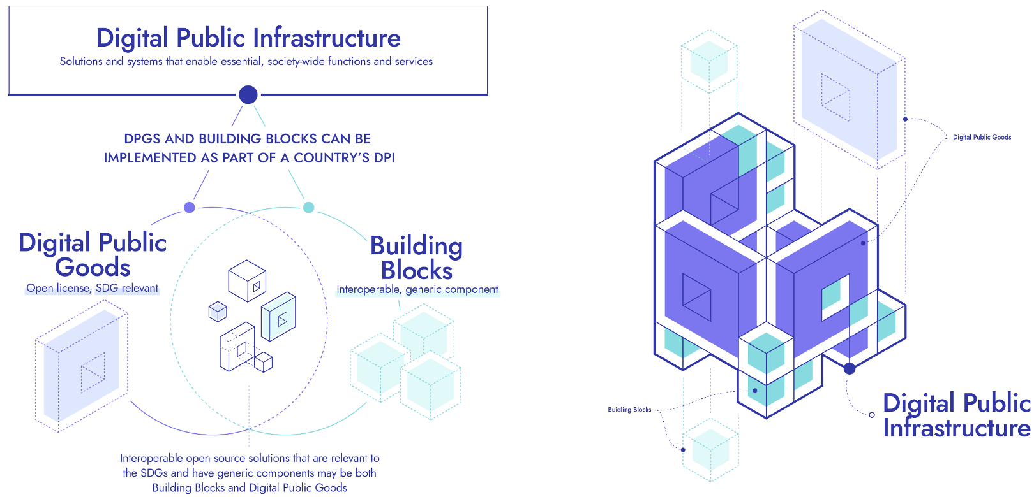
What is GovStack?

Slide 15
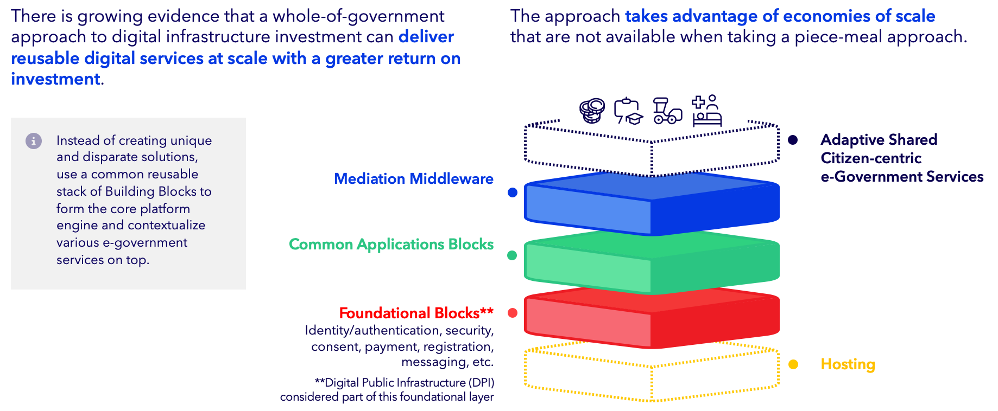
What is GovStack?

Slide 16
Payments BB
Vijay Mauree – Programme Coordinator, ITU

Slide 17
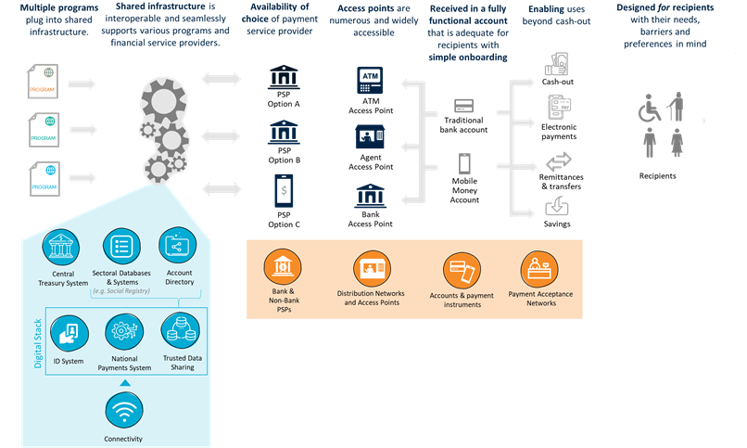
Vision of Payments Building Block
Interoperability and
Shared Infrastructure
Enablers to support different
access points and accounts
Caters for recipients needs
Connect
ID systems and
Government
programs
Infrastructure Dependencies
Source: World Bank
‹#›

Slide 18
Vision of Payments Building Block
Provides an architecture and functional specifications for implementing G2P and P2G payments
Leverages digital public goods
Based on open source software
Provides a standard set of Open APIs for implementing G2P and P2G payments

Slide 19
G2P payments flow – Option 1
Ministry and Department
Treasury - FMIS
Treasury Single Account (TSA)
Payment Service Provider (PSP)
Access Point
Beneficiary
Bank 1
ATM
Payment Gateway
FMIS
Central Bank
TSA
Bank 2
Bank Branch
Lumpsum Payment request
MMP1
Agent
Post
Post Office
Social Protection Payment System
Pension System
Payroll System
Retail – Welfare
Payment Scroll
Retail – Pension
Scroll
Retail – Payroll
Scroll
Retail Payment Info Is sent by email or in paper form to the PSP
Lump sum payments
MMP – Mobile Money Provider
Retail Payment Info
FMIS – Financial Management Information System

Slide 20
G2P payments flow – Option 2
Ministry and Department
Treasury - FMIS
Treasury Single Account (TSA)
Payment Service Provider (PSP)
Access Point
Beneficiary
Bank 1
ATM
Payment Gateway
FMIS
Central Bank
TSA
Bank 2
Bank Branch
Retail payment Scrolls
Agent
Lumpsum Payment request
MMP1
Lumpsum Payment request
Payment Portal
Post
Post Office
Social Protection Payment System
Pension System
Payroll System
Retail – Welfare
Payment Scroll
Retail – Pension
Scroll
Retail – Payroll
Scroll
Retail Payment Info Is accessed from the Payment Portal by PSP
Lump sum payment
MMP – Mobile Money Provider
Retail Payment Info
FMIS – Financial Management Information System

Slide 21
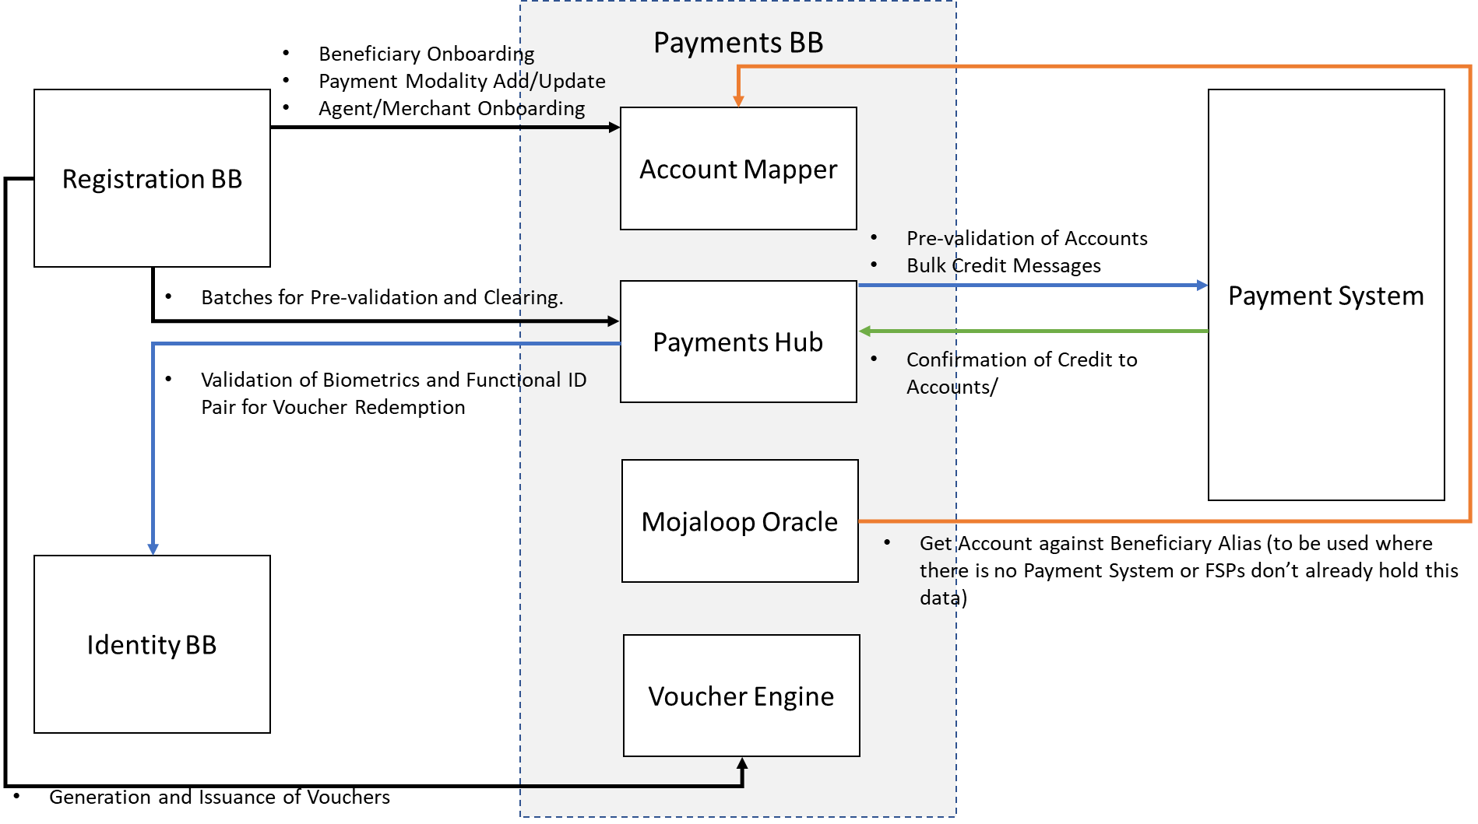
Payments BB Architecture for G2P Payments

Slide 22
Payments Building Block
Overview of design of Payment BB in ITU Gov Stack project

Slide 23
Context
The GovStack initiative is seeking to implement a demonstration/Proof-of-Concept (PoC) of the “Payments” Building Block (PAY-BB) as part of its Sandbox environment.
The Payments Building Block consists of components that enable multiple government payments use cases in a generic manner.
The actual use cases include Government to Person (G2P) and Person to Government (P2G).
The payments BB cover components that can be used to deliver the key functionalities and to connect to existing systems in the market, but does not contemplate building a new payments scheme.

Slide 24
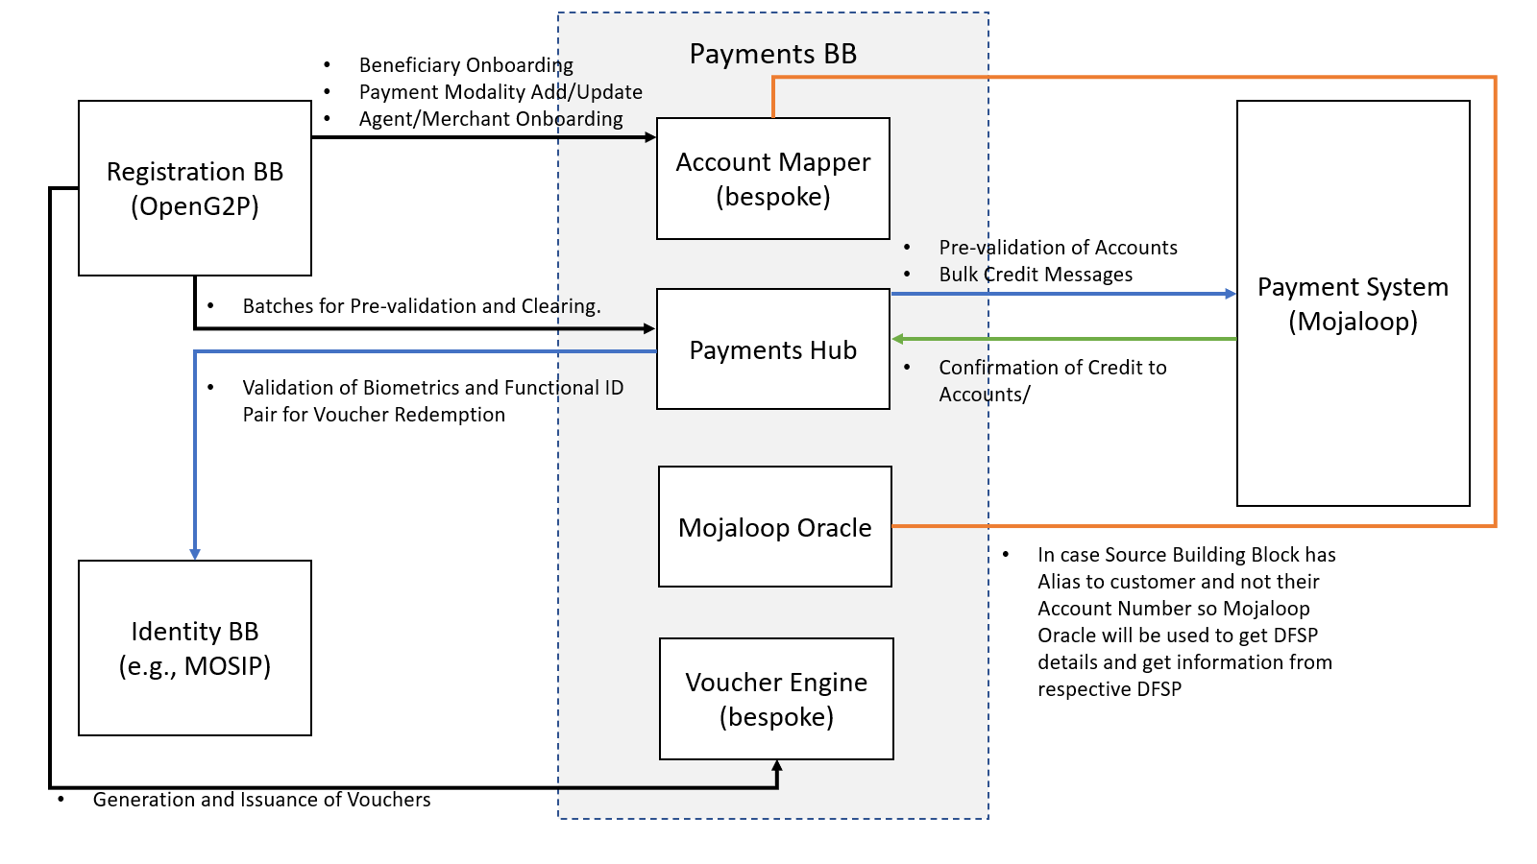
High level architecture

Slide 25
Use cases
Government to Person Payments (G2P)
Bulk payments
Need to support multiple payment modalities
Beneficiary has account
Beneficiary has Mobile money wallet
Beneficiary does not have any store of value (Voucher based payments)
For the first two variations where beneficiary has account or mobile money wallet, we use Bulk Push payment.
For Vouchers modality, we have designed it to be close to a “Request to Pay” scenario.

Slide 26
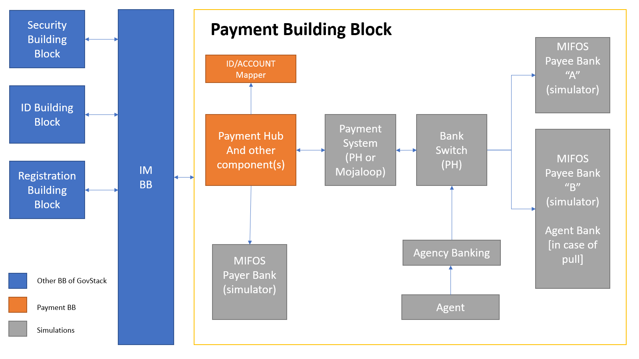
Payments BB – Sandbox environment
Payment System
(e.g., Mojaloop)

Slide 27
Account Mapper
Due to data privacy concerns, the Beneficiary identifier exchanged between different building blocks is defined as Functional ID
A Functional ID is a token based on combination of
Foundational ID - e.g. National ID
Identifier for the Government institution running the G2P program
Identifier for the G2P program itself. (Program ID)
The Account Mapper holds the mapping between Functional ID & Payment Modality.
Source Building block will register the Beneficiaries in Account Mapper alongwith the Payment Modality
Payment Modality could change over period of time e.g. As the data of beneficiaries is collected over time.
Same program can have different payment modality for different group of people (e.g. Pay by Account in one geographical area and Pay by Voucher in another)
Currently we have designed for following modalities
Pay by Account
Pay by Mobile Money wallet or Electronic money issuer
Pay by Voucher
This can be extended further to hold Alias (in case account information is not to be stored)

Slide 28
Bulk Payment – Push payments
At a high level, Payment BB will have three steps to process these payments
Bulk Pre-validation of accounts
Bulk transfers – execute clearing instructions
Confirmation by Payee institutions that all accounts are credited.
Typically, a Government entity will provide a Batch of payment instructions with Functional IDs & Amounts to be paid.
Pre-validation step includes
Verifying that Beneficiary is registered in Account Mapper and discovering the Payment modality
Validate the Accounts in Bulk with DFSP
DFSP checks if Account exists and can receive credit of the specified amount.
Exclude accounts which are either not present or cannot receive payments from next step i.e. Bulk Transfer

Slide 29
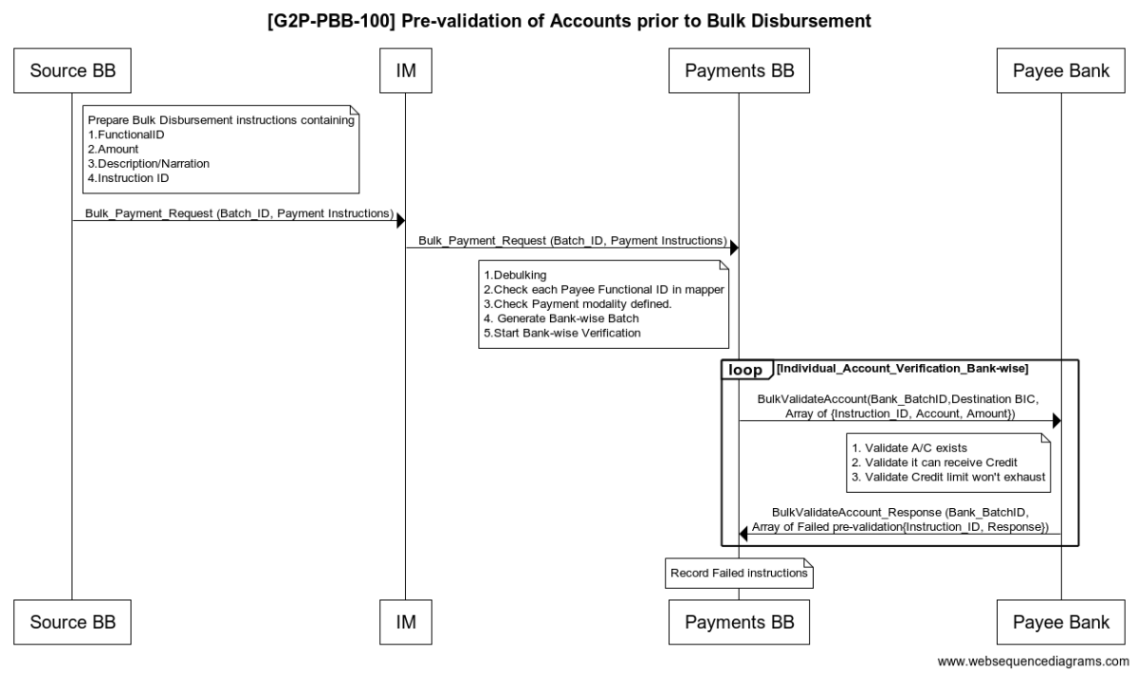
Bulk Payment – Pre-validation

Slide 30
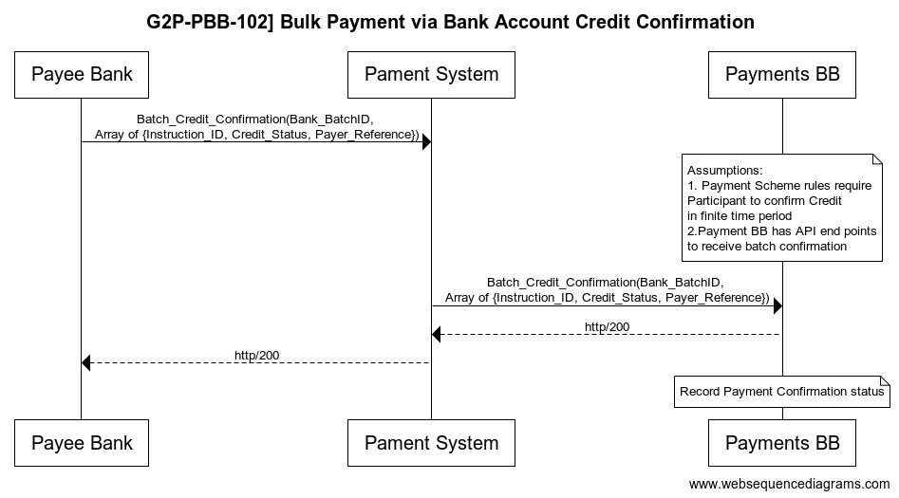
Bulk Payment – Credit confirmation
Considerations:
Since Batch Size of Bulk G2P payments may be large, an immediate confirmation of Credit won’t be available.
Once Bulk transfer is fully processed on Payee bank, Credit confirmation will allow Payments BB to notify the source building block

Slide 31
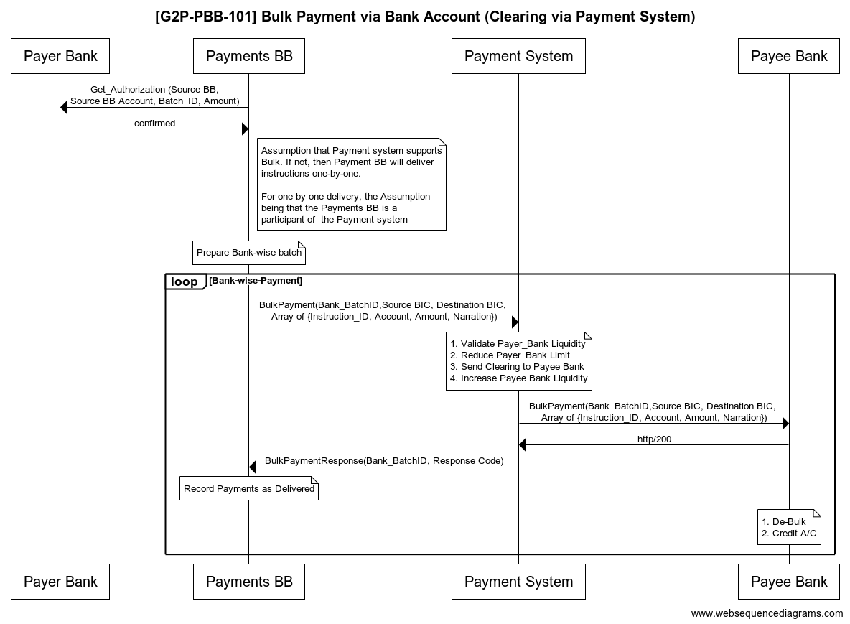
Bulk Payment – Transfers
Considerations:
1. Sending Bulk Transfer batches - “DFSP wise” for easy reconciliation
2. Clearing between institutions within Payment system. Does it happen immediately or only after final credit confirmation?
3. In case Clearing happens immediately then separate provision for Credit confirmation & Return payments

Slide 32
Voucher Payments
Voucher Payments are used when Beneficiary do not have
Payment BB will have Voucher Engine whose APIs include
Bulk Voucher Creation & Linking
Voucher Lifecycle Management APIs - Cancel, De-activate voucher etc.
Voucher Redemption
Voucher Redemption has two variations
Beneficiary goes to a registered Agent and presents voucher - Payments BB receives Voucher redemption request and validates Voucher and gives confirmation to redeem (like Request to Pay and Request to Pay confirmation).
Beneficiary goes to a registered Agent and presents voucher – Payments BB receives Voucher redemption request however Voucher requires person authentication also, so Agent gets response to capture Biometrics also which are then validated with ID Building Block.

Slide 33
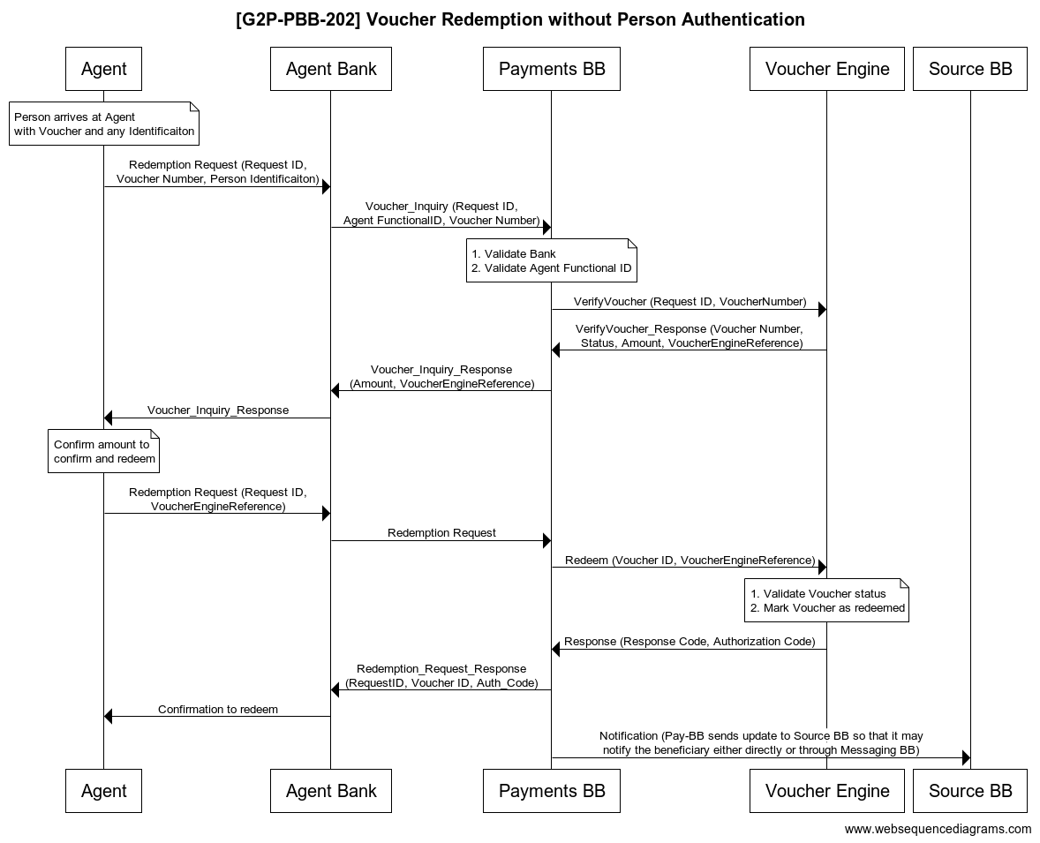
Voucher Redemption w/o Person auth
Considerations:
Use a standard Payment system for processing Request to Pay or not (Challenge is variations in how RTP leg is handled)
Once RTP is complete, the Payment BB pushes payment via Payment system – (transfer to Agent account)

Slide 34
Part 3 - Looking to the Future
What's next? What's on horizon and roadmap?
What does success look like? Where would you like to see the DPG/DPI space in 3 years?
Implementing Standards
What role do DPGs play in instantiating them? How is that occurring right now? How can DPGs practically get involved?
Collaboration
How will these standards enable better collaboration? Any good examples that you've seen to date?
Vendor Ecosystem
How are you addressing the challenges to adoption, maintainability and sustainability of projects and solutions?
Adoption & Country Engagement
How will your efforts scale adoption? How are governments and multilaterals involved? How do we drive proper stewardship & contribution from governments?
Sustainability
What risks/challenges come from increased interest? How are you ensuring your efforts translates into ensuring health, vitaliy, maintainability of DPGs and not just more standards to adhere to?
Notes:
We are going to break the panel into 3 segments

